Slide 1

DSA0309 - NATURAL LANGUAGE PROCESSING
CO1 AT2-TECHNICAL PRESENTATION
Derivational Morphology and Vocabulary Expansion
Supervised by:
Presented by:
Dr R Prem Kumar
Yoga Madha A(192425058)
Lathika S(192425066)
Ch Hymavathi(192425397)

Slide 2


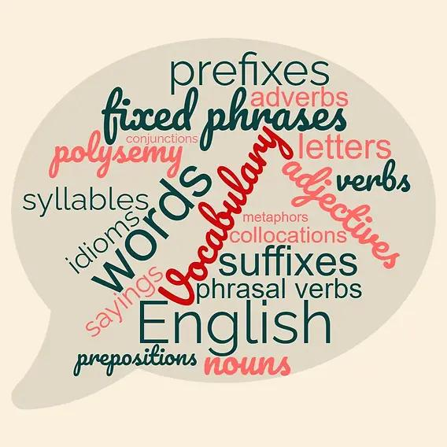
INTRODUCTION
Morphology is the study of word structure and word formation.
Derivational morphology explains how new words are formed from existing words.
Prefixes and suffixes can change a word's meaning or grammatical category.
Vocabulary expansion helps learners understand and use new words.
It is important in linguistics, education, and Natural Language Processing (NLP).

Slide 3

Aim and Objectives
Aim:
To analyze derivational processes and their impact on vocabulary expansion, semantic interpretation, and language understanding.
Objectives:
Identify common derivational prefixes and suffixes.
Understand how root words form new words.
Analyze changes in meaning and grammatical categories.
Explore the role of derivation in vocabulary learning.
Study applications in NLP and automated language analysis.

Slide 4
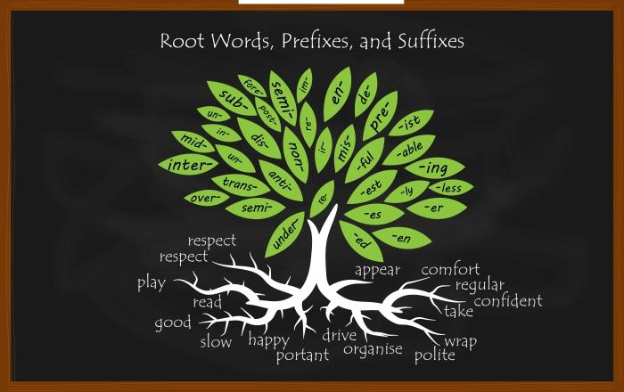
Basic Concepts of Morphology
Morpheme: The smallest meaningful unit of a word.
Root word: The central part that carries the basic meaning.
Prefix: An element added before a root word.
Suffix: An element added after a root word.
Derived word: A new word formed by adding a derivational affix.
Examples:
un + happy = unhappy
teach + er = teacher
happy + ness = happiness

Slide 5
Derivational vs. Inflectional Morphology
Derivational Morphology | Inflectional Morphology
Creates a new word or lexical meaning | Expresses grammatical information
May change the word class | Usually retains the word class
happy → happiness | book → books
teach → teacher | walk → walked
kind → unkind | tall → taller
Derivation expands vocabulary by creating related words.
Inflection expresses grammatical features such as tense, number, and comparison.

Slide 6
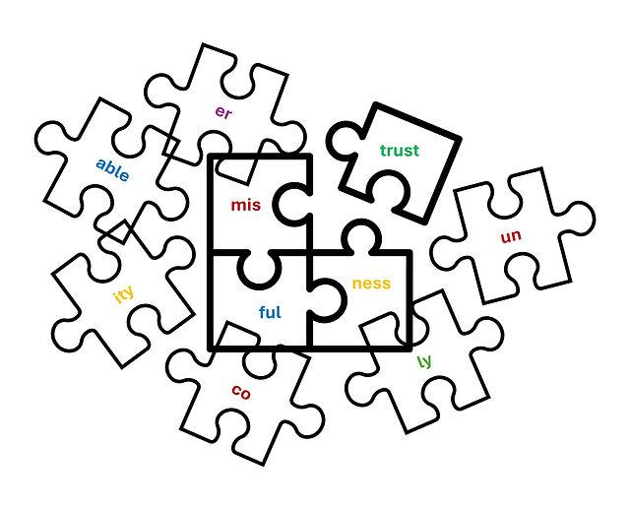
PROBLEM STATEMENT AND RESEARCH GAP
Problem Statement
Learners may struggle to understand unfamiliar derived words.
A derived word can have a different meaning or grammatical role from its root.
Identifying prefixes and suffixes alone may not reveal the intended meaning.
Research Gap
Some words do not follow predictable derivational rules.
Context can change the interpretation of a word.
A simple system combining morphological analysis and semantic interpretation can support vocabulary learning.

Slide 7
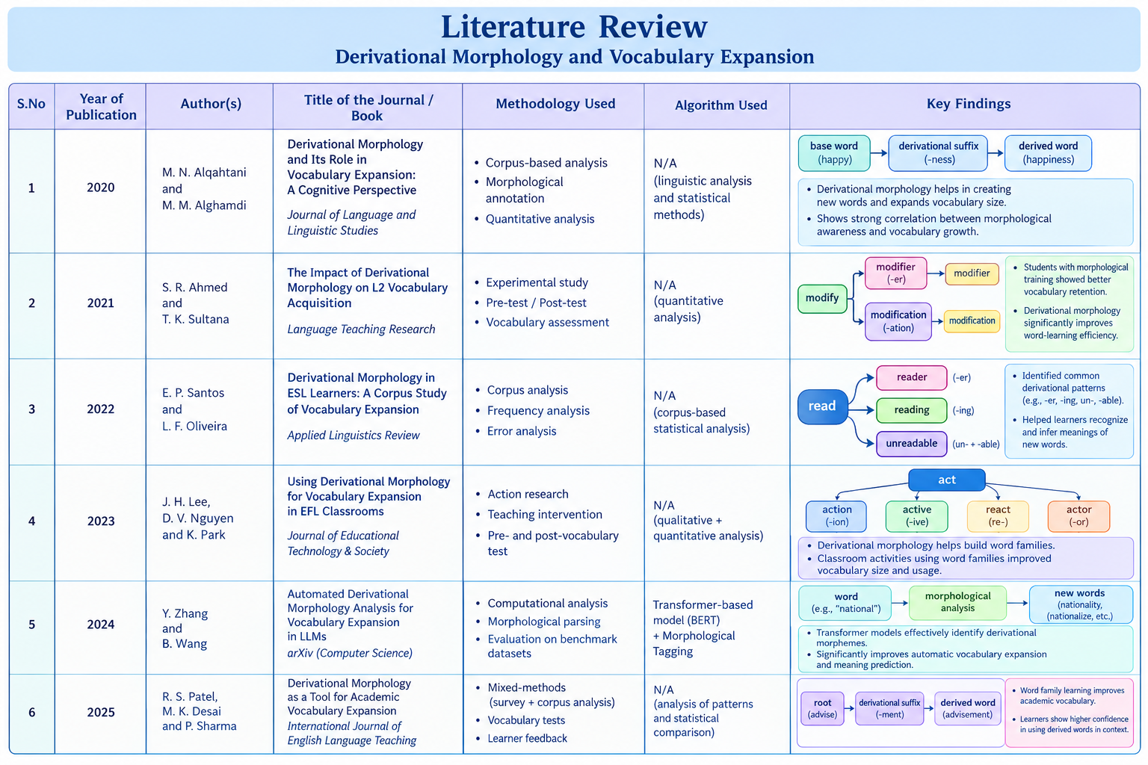

Slide 8
Types of Derivational Processes
Prefixation: Adding a prefix before a root word. Example: Possible → Impossible.
Suffixation: Adding a suffix after a root word. Example: Develop → Development.
Class-Changing Derivation: Changing the grammatical category. Example: Beauty → Beautiful.
Class-Maintaining Derivation: Forming a related word without changing its grammatical category. Example: Happy → Unhappy.
These processes create new vocabulary items and extend existing meanings.

Slide 9
PREFIXES AND SUFFIXES
Common Prefixes
Un-: Opposite or not — Unhappy.
Re-: Again — Rewrite.
Dis-: Opposite or absence — Disagree.
Mis-: Incorrectly — Misunderstand.
Pre-: Before — Preview.
Common Suffixes
-ness: Forms nouns — Kindness.
-er: Forms person nouns — Teacher.
-ful: Forms adjectives — Helpful.
-less: Without — Careless.
-ment: Forms nouns — Development.

Slide 10
PROPOSED SYSTEM AND WORKFLOW
Accept a root word or sentence as input.
Identify the root word and possible affixes.
Apply derivational rules to recognize or generate related words.
Identify the grammatical category of each derived word.
Analyze the meaning using a dictionary or sentence context.
Display the derived word, word category, and meaning.
Workflow:
Input Word → Root and Affix Identification → Derivational Analysis → Word-Class Identification → Semantic Interpretation → Output.

Slide 11
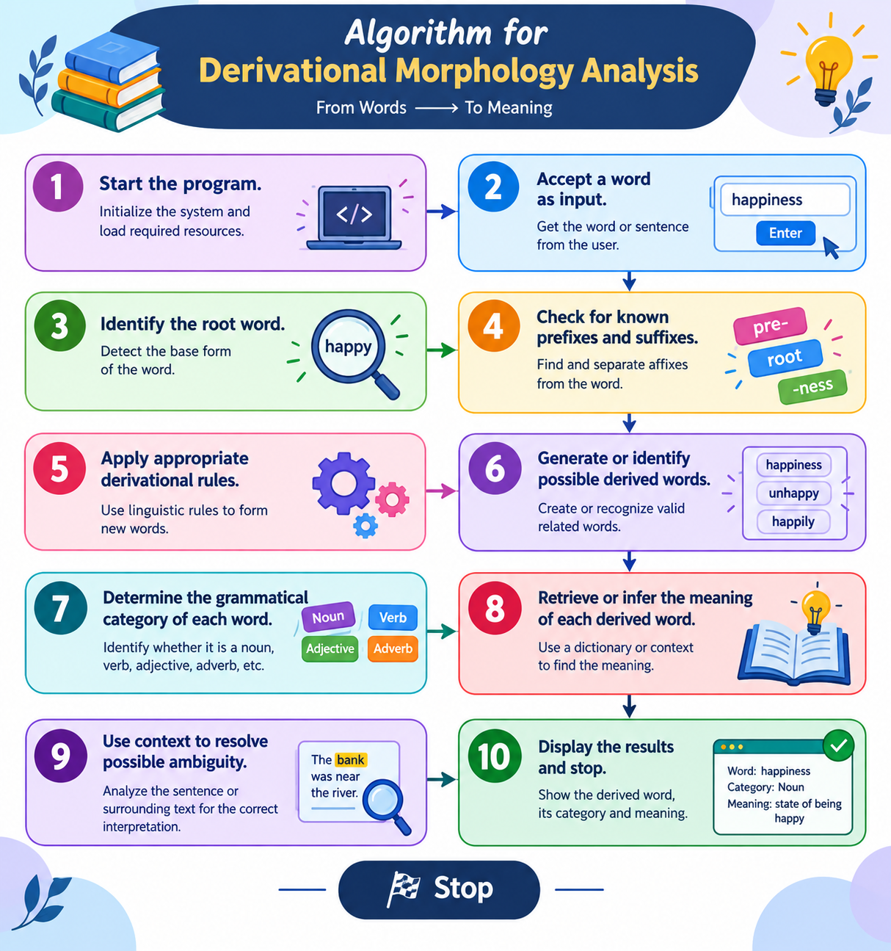
ALGORITHM DESIGN

Slide 12
SEMANTIC INTERPRETATION AND TECHNICAL ANALYSIS
Semantic interpretation identifies the meaning of a word.
Derivation can modify, reverse, or extend the root meaning.
Suffixes can change nouns into adjectives or verbs into nouns.
Context helps distinguish between different interpretations.
Morphological analysis supports automated vocabulary-learning tools.
Examples:
Happy: An adjective expressing a positive emotional state.
Unhappy: An adjective expressing the opposite state.
Happiness: A noun referring to the state of being happy.
Happily: An adverb describing how an action is performed.

Slide 13
PRACTICAL DEMONSTRATION
Root Word: CARE
Careful = Care + -ful — Showing attention.
Careless = Care + -less — Not taking sufficient care.
Carefully = Careful + -ly — In an attentive manner.
Carelessness = Careless + -ness — The state of not taking care.
Analysis:
Identify the root word.
Detect the suffixes.
Observe the changes in meaning.
Identify the grammatical category.
Explain how one root generates several vocabulary items.

Slide 14
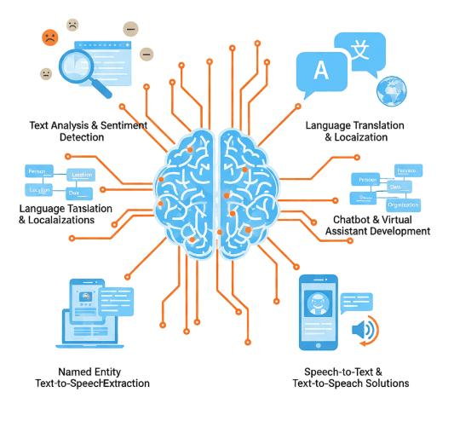
APPLICATIONS
Education: Supports vocabulary development and language learning.
Natural Language Processing: Helps analyze word structures and grammatical categories.
Search Engines: Helps recognize related word forms in queries.
Machine Translation: Provides morphological information for translation.
Spell-Checking: Supports recognition of valid word forms.
Text Analysis: Helps identify word usage and grammatical patterns.

Slide 15
LIMITATIONS AND FUTURE SCOPE
Limitations
Not every word follows predictable derivational rules.
The same affix can have different meanings.
Some derived words have meanings that cannot be inferred directly from their parts.
Context and language-specific rules influence interpretation.
Future Scope
Extend the system to additional languages.
Integrate dictionaries and NLP libraries.
Use machine learning to improve contextual interpretation.
Develop interactive vocabulary-learning exercises.
Evaluate the system using a larger word dataset.

Slide 16
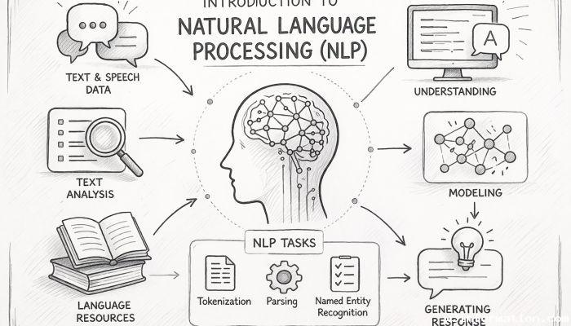
CONCLUSION
Derivational morphology is an important process of word formation.
Prefixes and suffixes create new words and expand vocabulary.
Derived words may differ in meaning and grammatical category.
Understanding roots and affixes helps learners interpret unfamiliar words.
Morphological analysis supports applications in education and NLP.
Contextual analysis can improve language understanding.

Slide 17
REFERENCES
[1] V. Hofmann, J. Pierrehumbert, and H. Schütze, “Superbizarre is not superb: Derivational morphology improves BERT’s interpretation of complex words,” in Proc. 59th Annu. Meeting Assoc. Comput. Linguistics and 11th Int. Joint Conf. Natural Language Processing (ACL-IJCNLP), 2021, pp. 3594–3608, doi: 10.18653/v1/2021.acl-long.279.
[2] D. Leontjev, A. Huhta, and A. Tolvanen, “L2 English vocabulary breadth and knowledge of derivational morphology: One or two constructs?,” Language Testing, vol. 40, no. 2, pp. 300–324, 2023, doi: 10.1177/02655322221114015.
[3] U. Nathaniel et al., “Decomposition in early stages of learning novel morphologically derived words: The impact of linear vs. non-linear structure,” Cognition, vol. 240, Art. no. 105604, 2024, doi: 10.1016/j.cognition.2023.105604.
[4] J. Baxi and B. Bhatt, “Recent advancements in computational morphology: A comprehensive survey,” arXiv preprint arXiv:2406.05424, 2024, doi: 10.48550/arXiv.2406.05424.
[5] S. Moeller, “Computational morphology for language documentation and description,” Colorado Research in Linguistics, vol. 25, 2021, doi: 10.33011/cril.v25i.1051.

Slide 18
THANK YOU!

